Slide 2
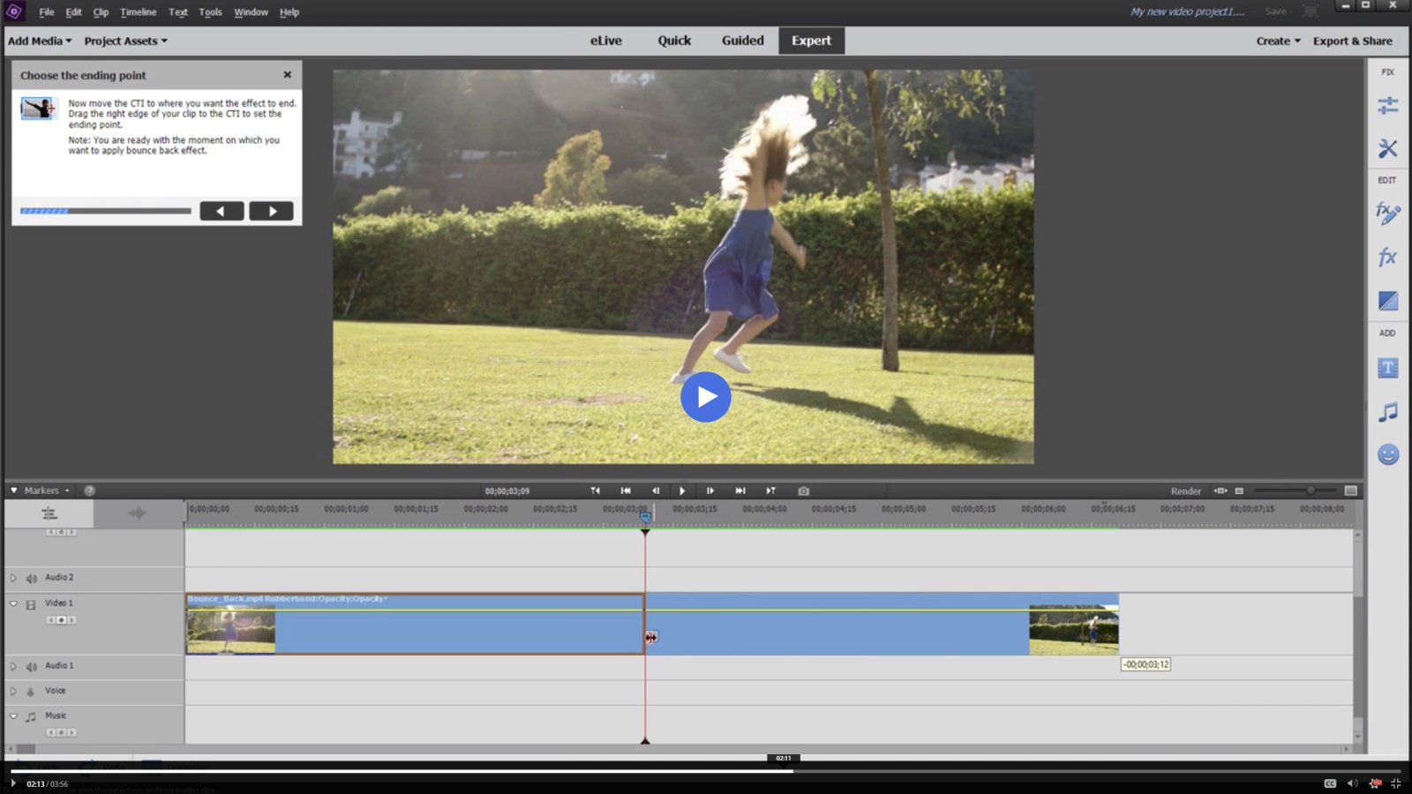
Adobe Premiere Elements

Slide 3
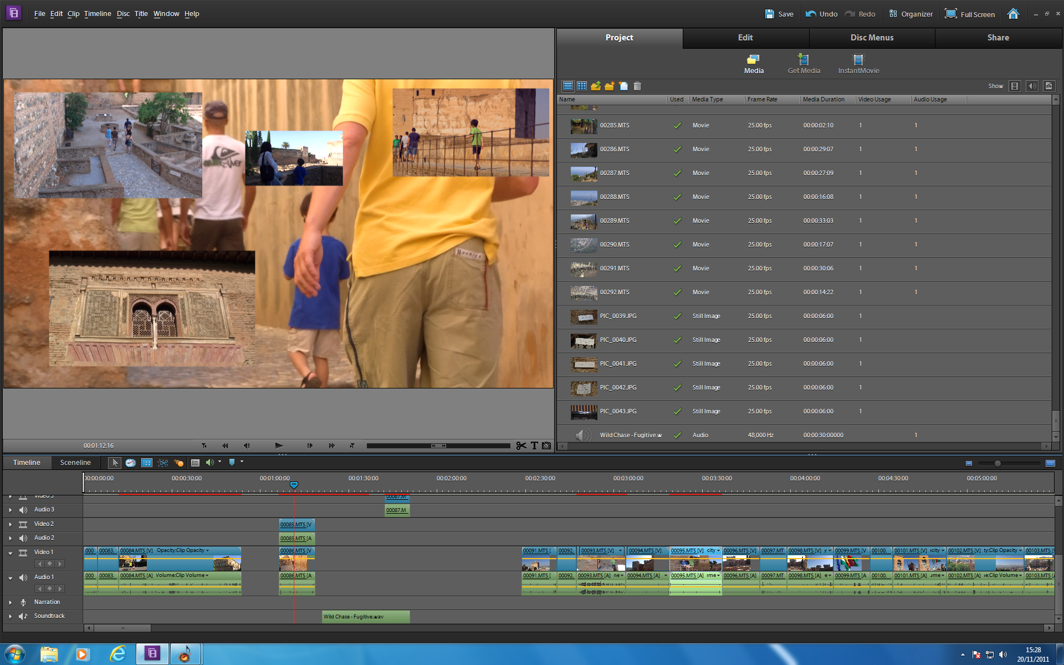
Adobe Premiere Elements 10

Slide 4
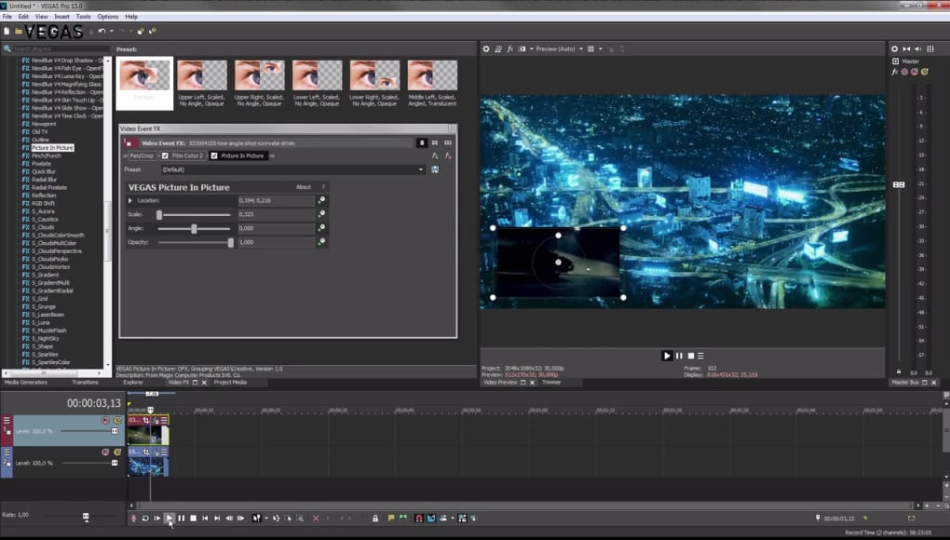
Sony Vegas Pro

Slide 5
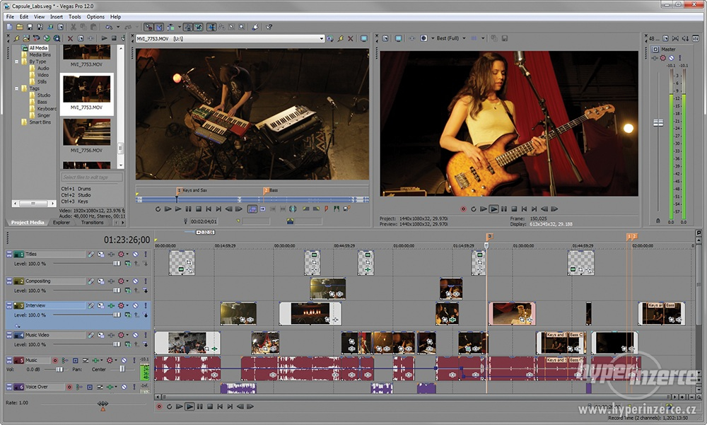
Sony Vegas Pro 12

Slide 6
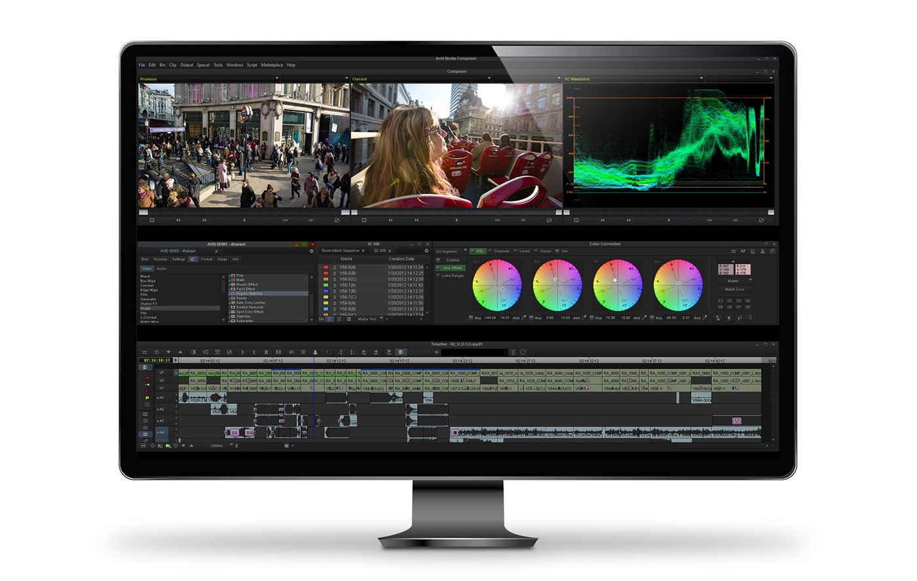
Avid Media Composer

Slide 7
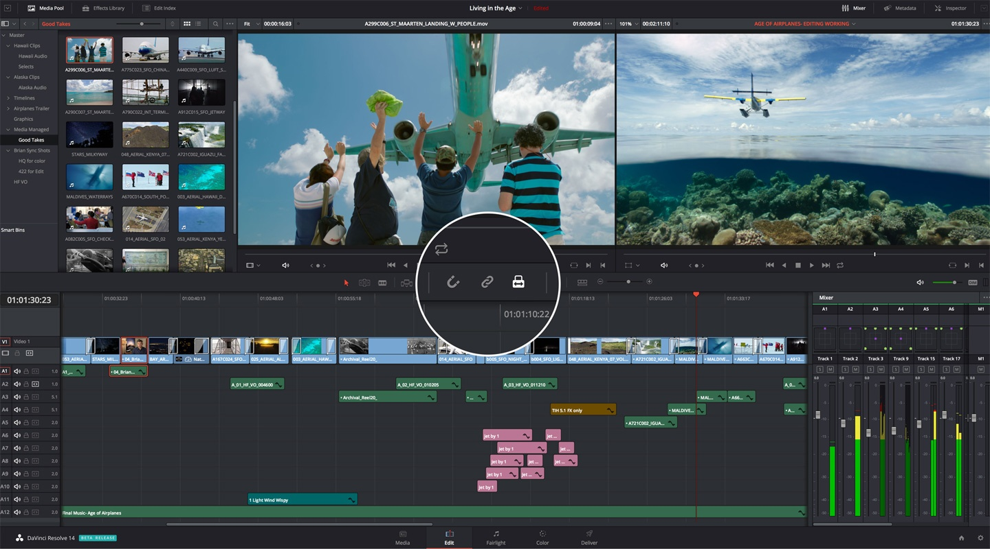
DaVinci Resolve

Slide 8
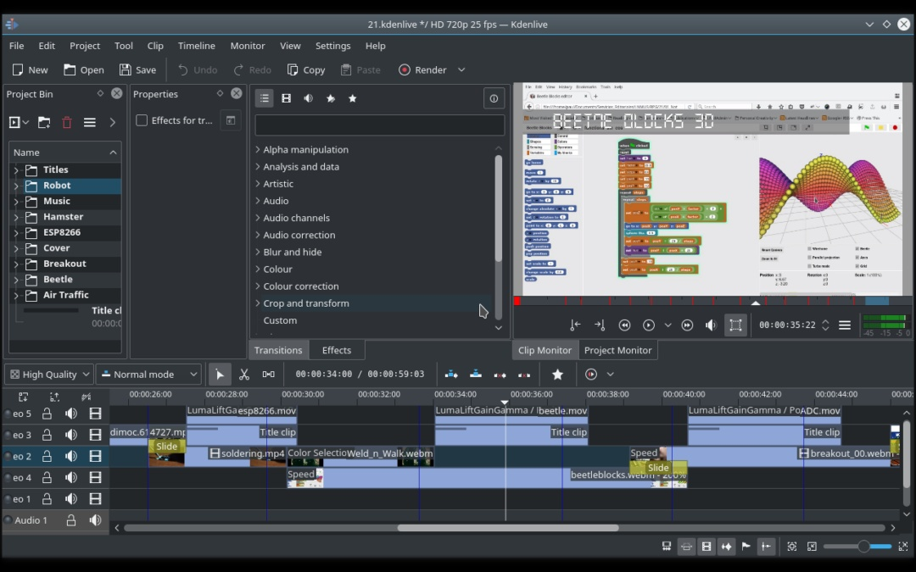
Kdenlive – freeware (Linux, Windows)

Slide 9
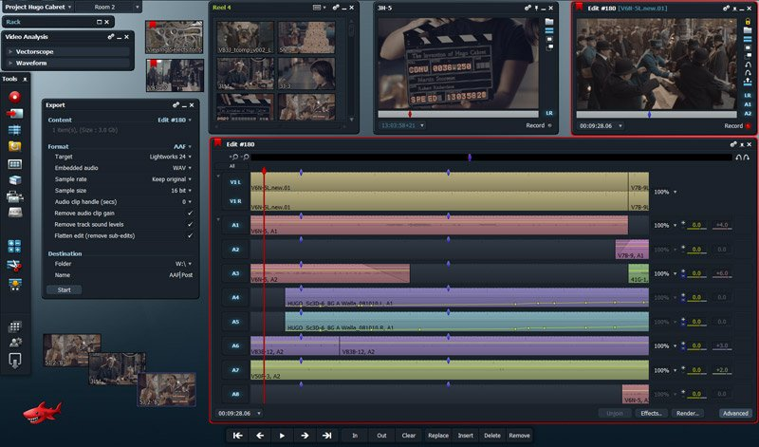
Lightworks

