Slide 1
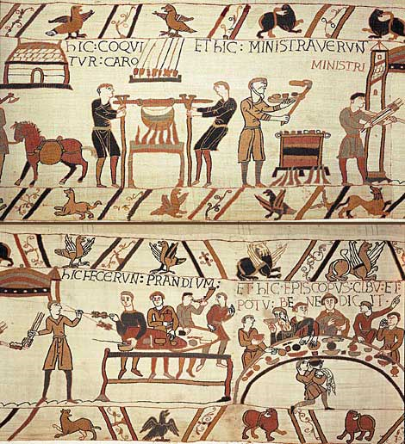
The Dawn of British Culture

Slide 2
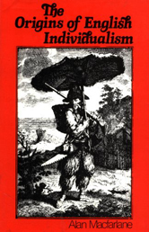
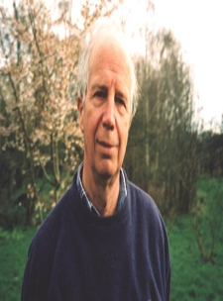
Is English history „different“?
English exceptionalism: put forward by historian and anthropologist Alan Macfarlane (born 1941) argument: English society has differed from Continental societies since the Middle Ages, as it moved towards liberty and capitalism
History of trading (the English were unusually market-oriented from medieval times; work for wages, business skills
Common Law system (law of the land as opposed to laws imposed by monarchs)
Early industrialization
Nuclear family, rather than large extended clans ideal for development of capitalism

Slide 3
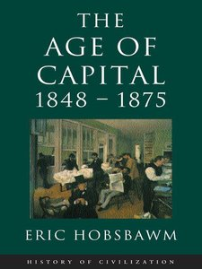
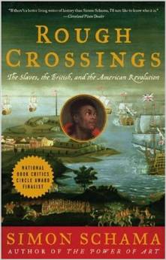
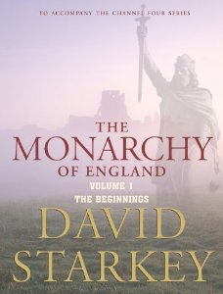
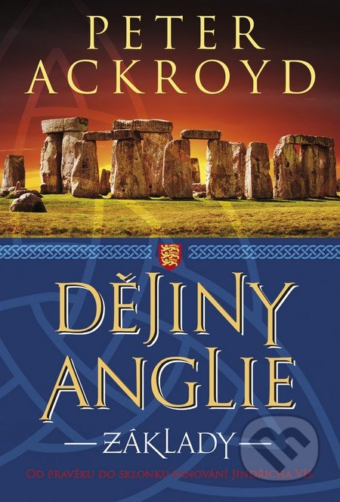
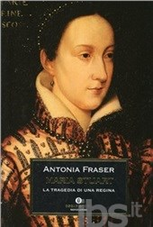
Some prominent English historians
Eric Hobsbawm
Peter Ackroyd
Simon Schama
David Starkey
Antonia Fraser

Slide 4
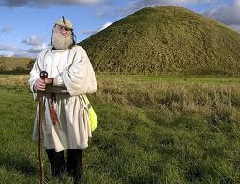
Origins of the names „Britain“ and „England“
The name "England" is derived from the Old English name Englaland, meaning "land of the Angles“ > one of the Germanic tribes that settled in Great Britain during the Early Middle Ages. The Angles arrived from the Angeln peninsula in the Bay of Kiel area of the Baltic Sea.
Oxford English Dictionary: the first known use of "England" occurs in 897, and its modern spelling was first used in 1538.
325 – A Greek merchant and explorer Pytheas landed in England
Named the island Prettanike (according to a tribe of "painted" people, or "Prettani”)
Prettanike means, roughly, land of the painted people.

Slide 5
The Celtic Period
Celtic Britain (The Iron Age) c. 600 BC - 50 AD
This period – fashionable today + subject to a number of myths
First of all, the inhabitants of Britain of this period were not “Celts” > this idea comes from the 18th century based on linguistic similarities with continental Gauls
> a group of tribes (Trinovantes, Atrebates, Dumnonii, Silures, Cornovi, Iceni …) sharing some language, religious and cultural similarities
However, there is no collective identity

Slide 6
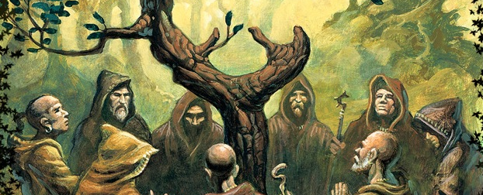
Character of the Celtic tribes
Strong tribal identity; tribes led by warrior aristocracy (presiding over a population of warriors, priests, craftsmen and farmers)
Existence of defended wooden hillforts
Extensive farming, commerce, metal production
Druids > a powerful priestly class
  lawmakers
  practiced worship of sacred places
  (trees, caves, streams)
  human sacrifice
  knowledge passed on orally; no writing
  practice of divination, magic, astrology

Slide 7
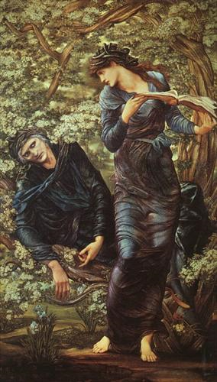
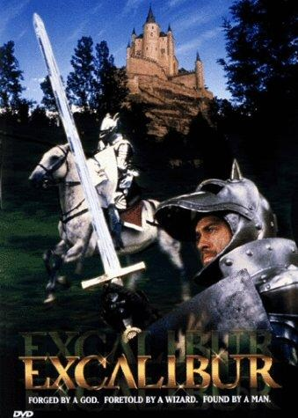
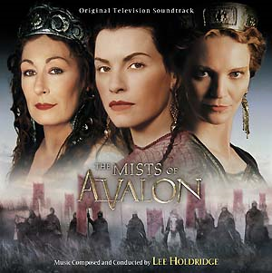
The Celtic Legacy I – Arthurian Legends

Slide 8
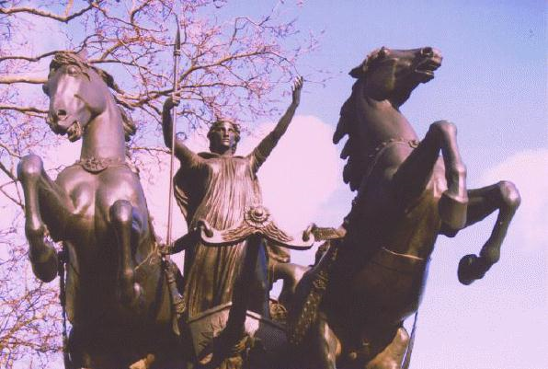
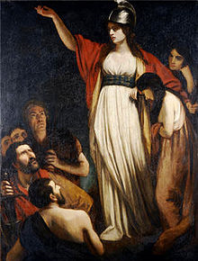
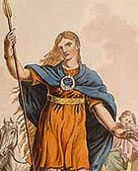
The story of Boudicca, a warrior queen taking revenge on the Romans (AD 61)
"She was huge of frame, terrifying of aspect, and with a harsh voice. A great mass of bright red hair fell to her knees: She wore a great twisted golden necklace, and a tunic of many colors, over which was a thick mantle, fastened by a brooch. Now she grasped a spear, to strike fear into all who watched her...…" -Dio Cassius (Dudley and Webster, 54)

Slide 9
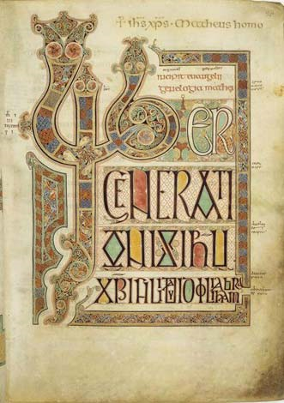
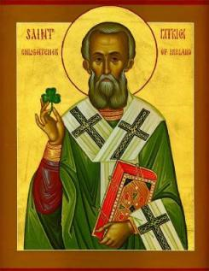
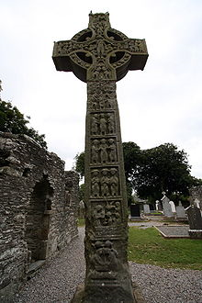
Celtic Christianity
St. Patrick; the Lindisfarne Gospels; a Celtic Cross

Slide 10
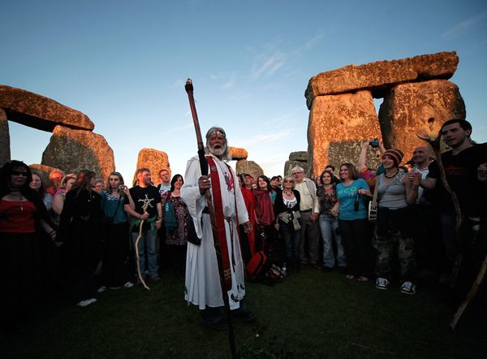
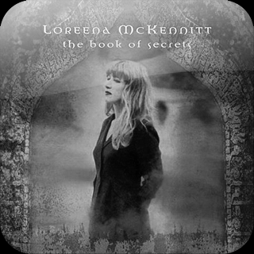
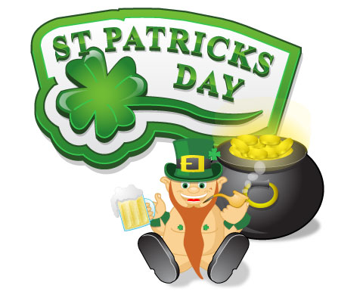
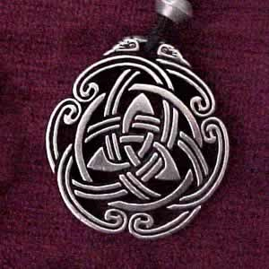
Popular Celtic legacy
– Loreena Mc Kennit; Spirituality – New Age/Druidism; St Patrick's Day; Celtic jewellery
Design – Celtic jewellery; St Patrick’s Day

Slide 11
Celtic impact on the English language
there are very few borrowings from Celtic languages in English
Common nouns – ambassador, bard, bucket, car, career, cargo, carpenter, carry, flannel, glen, slogan, truant.
Place names –Thames, Avon, Severn, Ouse
- London, Exeter, Gloucester, Manchester, Salisbury (despite the Roman and Anglo-Saxon endings)

Slide 12
Roman Britain (AD 43 - CCA 410)
AD 43 > Britain invaded by the army of Emperor Claudius (in his attempt to gain prestige)
The Romans – established a provincial government, and a specific Romano-British culture emerged
“The Roman invasion of Britain was arguably the most significant event ever to happen to the British Isles. It affected our language, our culture, our geography, our architecture and even the way we think. Our island has a Roman name, its capital is a Roman city and for centuries (even after the Norman Conquest) the language of our religion and administration was a Roman one.“
Dr Mike Ibeji: An Overview of Roman Britain
http://www.bbc.co.uk/history/ancient/romans/questions_01.shtml

Slide 13
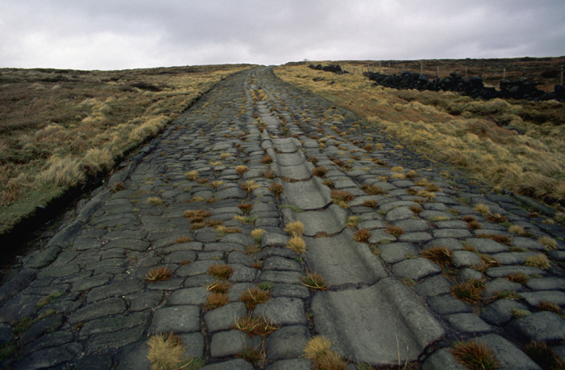
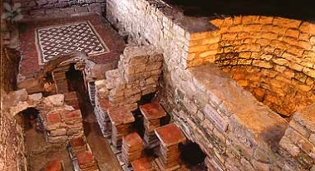
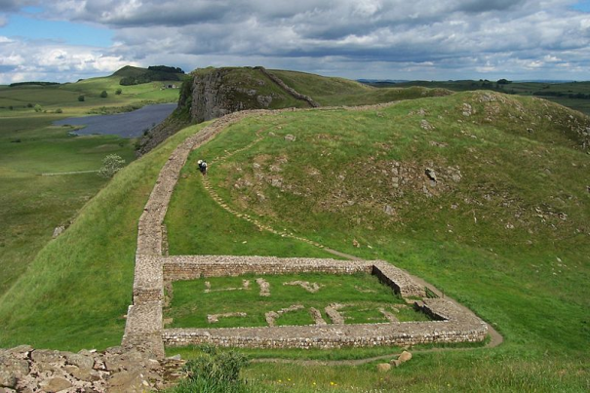
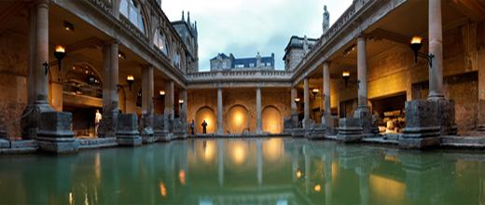
All right... all right... but apart from better sanitation and medicine and education and irrigation and public health and roads and a freshwater system and baths and public order... what have the Romans done for us? Monty Python: The Life of Brian

Slide 14
Anglo-Saxon Britain (410-1066)
the term “Anglo-Saxon” > relatively modern
It refers to invading Germanic tribes from across the North Sea who began to settle in Britain after the withdrawal of Roman troops in 410
The Angles – settle along the East Coast
The Saxons – in the South and West (all the shires ending in –sex > Sussex, Wessex, Middlesex, Essex)
The Jutes – in Kent
Early historical accounts of the invasion (Gildas, Bede) > state that the Saxons were invited to Britain by local kings to defend them from the attacks of the Picts
In reality > the invasion was probably caused by tensions on the Continent (pressed by the arrival of other tribes > the Angles and Saxons seek new territory and livelihood)

Slide 15
Anglo-Saxon Britain (410-1066)
- the term “Anglo-Saxon” > relatively modern
It refers to invading Germanic tribes from across the North Sea who began to settle in Britain after the withdrawal of Roman troops in 410
The Angles – settle along the East Coast
The Saxons – in the South and West (all the shires ending in –sex > Sussex, Wessex, Middlesex, Essex)
The Jutes – in Kent
Early historical accounts of the invasion (Gildas, Bede) > state that the Saxons were invited to Britain by local kings to defend them from the attacks of the Picts
In reality > the invasion was probably caused by tensions on the Continent (pressed by the arrival of other tribes > the Angles and Saxons seek new territory and livelihood)

Slide 16
More on the Anglo-Saxons
“So far as is known, they had a very imperfect and unformed political organization. Their kings were merely chieftains who led them in way; their political meetings were the gatherings of leading men, or of the whole fighting force of the tribe, to decide on warlike adventures; their villages were collections of thatched huts made of wood or turf; and their agriculture consisted principally of yearly ploughings of the soil and the raising of oats, beans, barley, and the like. The people were divided into nobles, freemen, and slaves; their villages were inhabited by families united by blood and religious ties; all lived on flesh, milk, and grains, and because of the wet climate and their rough life, they were heavy drinkers of mead and ale.“
Charles M Andrews: History of England Part 1 http://britain.library4history.org/Andrews-Celts-Henry-III/ANGLO-SAXON-CONQUEST/Anglo-Saxons-and-Jutes.html

Slide 17
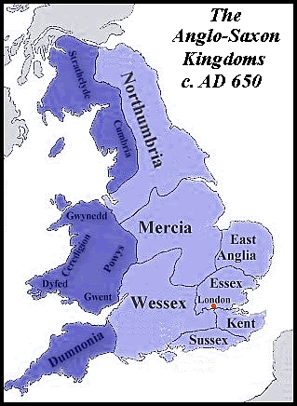

Slide 18
Anglo-Saxons and Religion
The Anglo-Saxons - pagans worshipping a series of Germanic gods > Tiw/Tyr (Tuesday) Woden/Odin (Wednesday), Frige/Frigg (Friday), etc.
The religion has a practical use > invoking deities to secure a good harvest, success in battle, well-being of family, etc.
A fatalistic worldview > fate (wyrd) dictates how one will live and die; in a society of warfarers, death was a way of life
Belief in afterlife > reflected in burial habits (the dead are buried along with their treasured belongings/weapons)
Noblemen – buried in barrows or ship burials
Belief in magic, witchcraft, charms

Slide 19
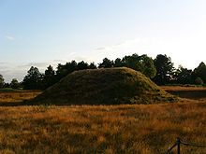
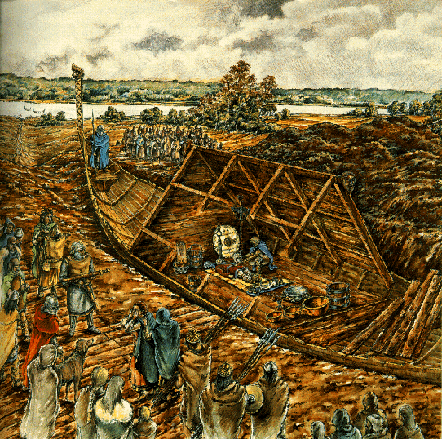
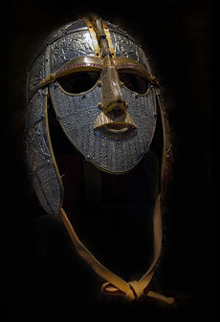
Anglo-Saxon Burial
The Sutton Hoo ship burial plus a burial mound

Slide 20
Anglo-Saxons and Christianity
The arrival of Christianity > one of the most significant developments of English history
2 main sources:
A] Celtic Christianity - St. Columba (founder of the Iona monastery in Scotland) and St. Aidan (founder of Lindisfarne in Northumbria)
B] Latin Christianity - brought to Britain by St. Augustine of Canterbury in 597, sent by the Pope to christianize the English people
Augustine – had more success with pagans than with Celtic Christians
Augustine’s strategy > to purify rather than destroy pagan temples and customs; transform pagan rites into Christian feasts; keep local customs as much as possible
The Latin Church (better organized) > gained supremacy in the 7th century

Slide 21
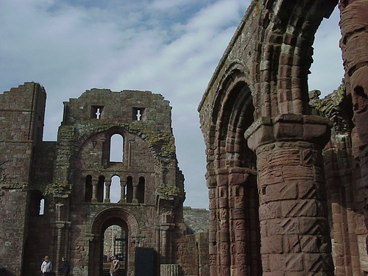
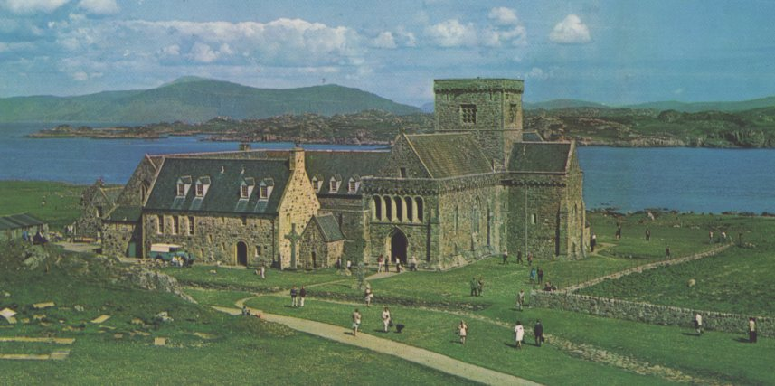
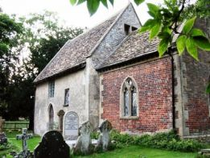
Anglo-Saxon Christianity
The monasteries of Iona and Lindisfarne; a Saxon church in Wiltshire

Slide 22
On the Anglo-Saxon society
A major aspect – loyalty to one’s lord/king
The lord – owned a hearth-hall where his warriors were housed
Local people fed the warriors with their produce, in return for protection from the lord
The image of the hearth-hall > present in the Anglo-Saxon epic poem Beowulf
Women in the Anglo-Saxon society > enjoy much greater equality than later in the Middle Ages
can own property, can choose their husbands, can pursue their destinies (see the Lord of the Rings > the characters of Eówyn, Arwen, etc.) Marriage taken very seriously; strong emphasis on monogamy; the idea of the match as a „friendship“

Slide 23
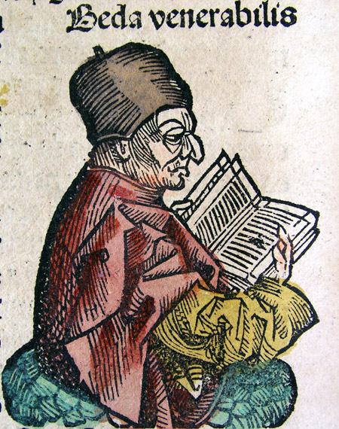
Key works of the A-S period
The Anglo-Saxon Chronicle = a collection of annals created in the 9th century (under Alfred the Great), describing the history of the Anglo-Saxons.
The Ecclesiastical History of the English People = a work by the Northumbrian monk and scholar Venerable Bede („The Father of English History“) dealing with Christianity in England and English history in general
Anglo-Saxon poetry (Beowulf, Wanderer, Seafarer, The Dream of the Rood, the poems of Caedmon)

Slide 24
From the poem “Wanderer”
Oft him anhaga are gebideð,
metudes miltse, þeah þe he modcearig
geond lagulade longe sceolde
hreran mid hondum hrimcealde sæ
wadan wræclastas. Wyrd bið ful aræd!
Swa cwæð eardstapa, earfeþa gemyndig,
wraþra wælsleahta, winemæga hryre.
Often the solitary one
finds grace for himself
the mercy of the Lord,
Although he, sorry-hearted
must for a long time
move by hand
along the waterways,
(along) the ice-cold sea,
tread the paths of exile.
Events always go as they must!
So spoke the wanderer,
mindful of hardships,
of fierce slaughtersand the downfall of kinsmen.

Slide 25
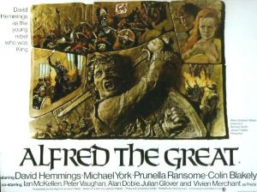
Alfred the Great
Alfred the Great (849-899) – a king of Wessex, a warrior as well as scholar
His reign – plagued by the raids of Danes, from which he emerged victorious
His intellectual endeavours > translations of historical and religious texts (e.g. Bede’s Ecclesiastical History), founding of monasteries and schools
  ambition to improve education in his kingdom;
  formulating a new code of law
one of the most significant English
monarchs (the only one to be titled “Great”)

Slide 26
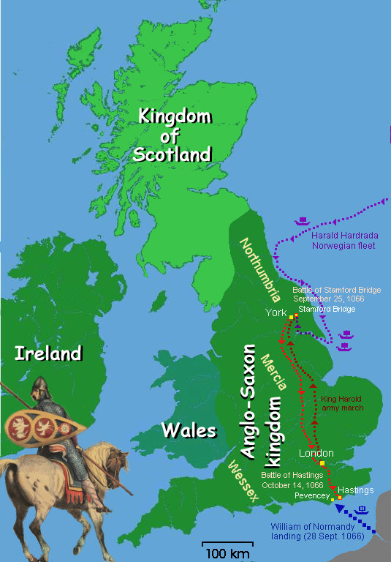
The Norman Conquest
The Anglo-Saxon period - ends in 1066 with the invasion of William of Conqueror, Duke of Normandy
Normans - Viking settlers in northern France adjacent to the North Sea
- their language – mix of French and Norse
1066 – death of a childless Anglo-Saxon king Edward the Confessor
William – claims the throne > victorious in the battle of Hastings against the army of Harold Godwinson, a powerful Anglo-Saxon nobleman who proclaimed himself King after Edward's death

Slide 27
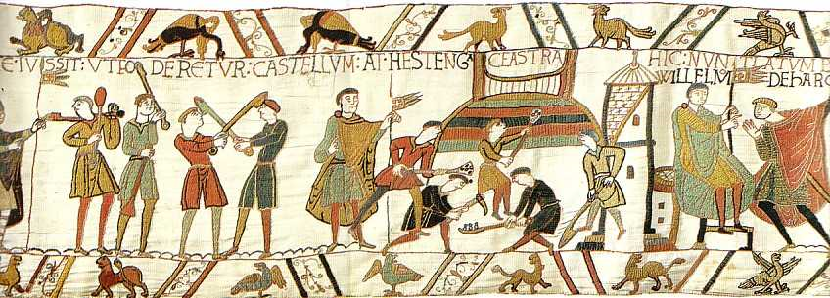
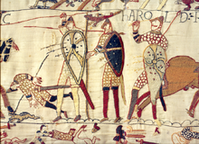
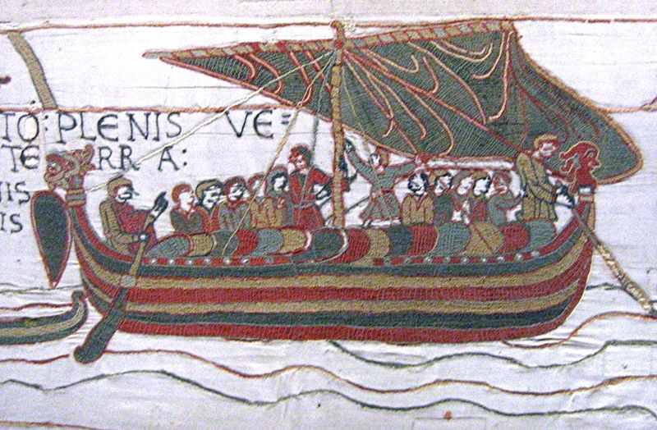
Bayeux tapestry: embroidered cloth 70 metres (230 ft) depicting the events leading up to the Norman conquest

Slide 28
After Hastings
Despite the lost battle, Anglo-Saxon nobility continues in its resistance
Normans (only 8 000 them in England) > gain control through innovative methods
  confiscations from Anglo-Saxon lords
  building castles and fortifications
  filling important government and church posts with his Norman loyals
Result > almost total replacement of the A-S elite with Normans, with a huge impact on English society
Walter Scott´s historical novel Ivanhoe (1819) – treats the tension between the last of the Anglo-Saxon nobility and the new Norman rulers
´

Slide 29
Changes under the Normans
  Replacement of the ruling élite, end of the Anglo-Saxon way of life
  England moves from the periphery to very close contact with the Continent
  A system of centralized government with very efficient administration (via Domesday Book)
  Feudalism - receiving land from a lord in return for loyalty and service
  Increased power of the Church (the Norman bishops very close to the Monarch)
Loss of women´s rights > the relative freedom of A-S women replaced with increased subordination
  “The Norman Conquest brought with it the customs and laws of the Normans. This had a negative impact on the position of women. Now they had a very limited share in the feudal land-owning and politics; their role was 'to marry and to serve'. The wife was given in marriage as a token of land-transfer, and the husband owned everything. Children were married off young; women were sold to whoever offered the most to the lord. Only peasants could marry out of love. The only women with relative freedom to do what they wanted were rich widows who paid the fee for self-determination to their lord“. http://www.hullwebs.co.uk/content/c-anglo-saxon/home-life/anglo-saxon-women.htm

Slide 30
Changes under the Normans
Language
Norman French – became the language of the ruling class > dramatically changed the native English > transformed into Middle English
a huge amount of borrowing from French, and loss of Anglo-Saxon wordstock
- words describing common names and processes – remain Anglo-Saxon, whereas more technical, abstract or prestige-related terms > French
Famous food example: pig, swine (AS) x pork (F);
sheep (AS) x mutton (F), cow (AS) x beef (F), deer (AS) x venison (F)

Slide 31
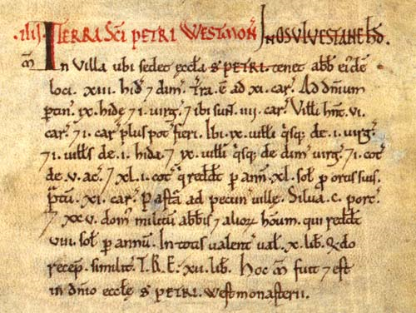
From the Domesday Book
IIII. The Land of St. Peter of Westminster
In ‘Ossulstone’ Hundred
In the vill in which St. Peter’s Church is situated [Westminster] the abbot of the same place holds 13½ hides. There is land for 11 ploughs. To the demesne belongs 9 hides and 1 virgate, and there are 4 ploughs. The villeins have 6 ploughs, and there could be 1 plough more. There are 9 villeins each on 1 virgate and 1 villein on 1 hide, and 9 villeins on each half a virgate and 1 cottaron 5 acres, and 41 cottars who pay 40 shillings a year for their gardens. [There is] Meadow for 11 ploughs, pasture for the livestock of the vill, woodland for 100 pigs, and 25 houses of the abbot’s knights and other men who pay 8 shillings a year. In all it is worth £10

Slide 32
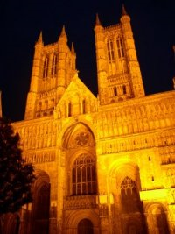
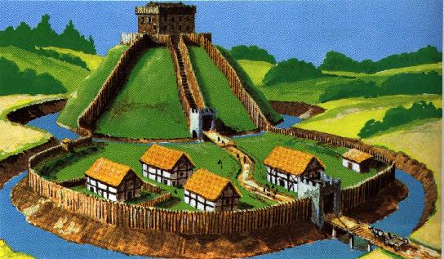
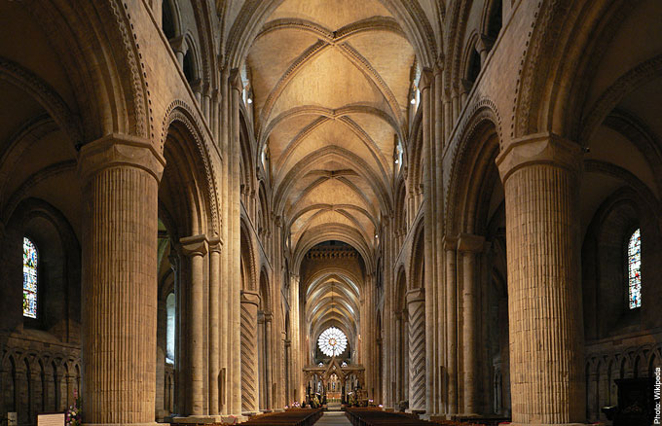
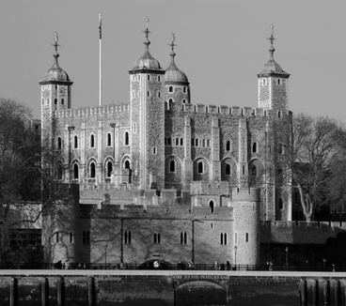
Some aspects of Norman Culture

