Slide 1
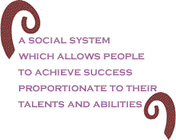
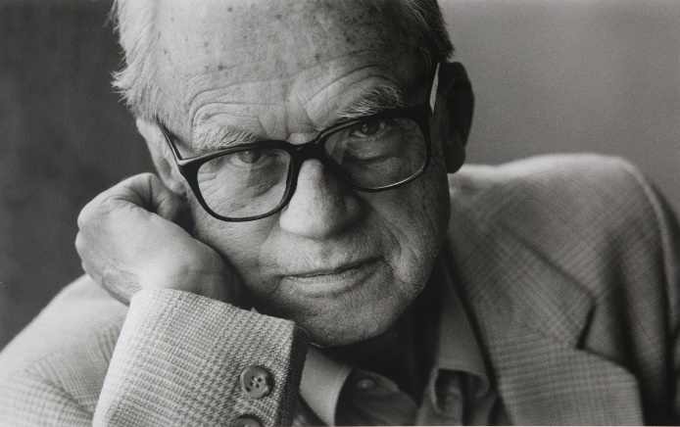
Meritocracy
Michael Young (British sociologist)
"merit is equated with intelligence-plus-effort, its possessors are identified at an early age and selected for appropriate intensive education, and there is an obsession with quantification, test-scoring, and qualifications."
Danger of meritocracy – leads to elitism

Slide 2
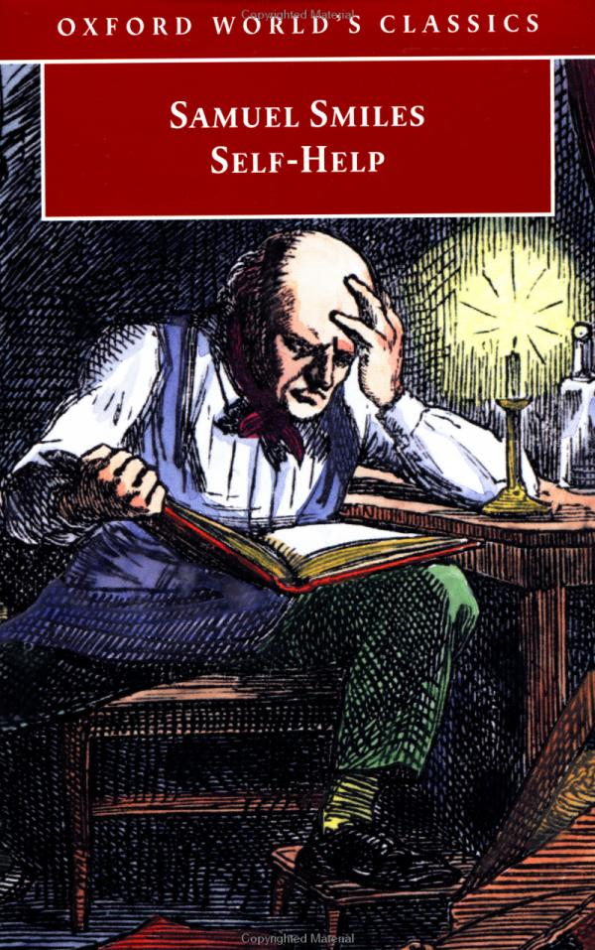
The obsession with self-help and self-improvement
“Heaven helps those who help themselves” is a well-tried maxim, embodying in a small compass the results of vast human experience. The spirit of self-help is the root of all genuine growth in the individual; and, exhibited in the lives of many, it constitutes the true source of national vigour and strength. Help from without is often enfeebling in its effects, but help from within invariably invigorates. What-ever is done FOR men or classes, to a certain extent takes away the stimulus and necessity of doing for themselves; and where men are subjected to over-guidance and over- government, the inevitable tendency is to render them comparatively helpless.

Slide 3
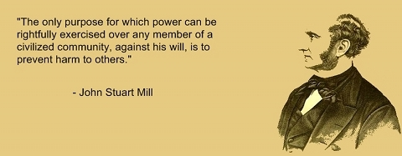
John Stuart Mill
In normative ethics, a tradition stemming from the late 18th- and 19th-century English philosophers and economists Jeremy Bentham and John Stuart Mill that an action is right if it tends to promote happiness and wrong if it tends to produce the reverse of happiness—not just the happiness of the performer of the action but also that of everyone affected by it. Such a theory is in opposition to egoism, the view that a person should pursue his own self-interest, even at the expense of others, and to any ethical theory that regards some acts or types of acts as right or wrong independently of their consequences. Utilitarianism also differs from ethical theories that make the rightness or wrongness of an act dependent upon the motive of the agent; for, according to the Utilitarian, it is possible for the right thing to be done from a bad motive.
The nature of Utilitarianism
Utilitarianism is an effort to provide an answer to the practical question “What ought a man to do?” Its answer is that he ought to act so as to produce the best consequences possible.
https://www.utilitarianism.com/utilitarianism.html

Slide 4
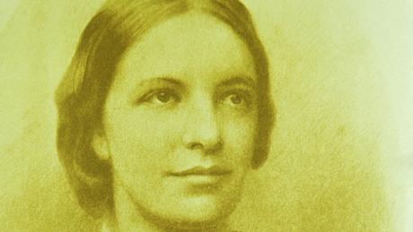
Octavia Hill
Campaigner for better housing for the poor (not based on state help but on charity with private participation)
Social responsibility required of the tenants; regular visitations on the occasion of rent collection – a form of social work
Founder of National Trust
  Idea – places of historic and natural beauty should be available to all
Campaigner for open spaces for urban dwellers: ‘a few acres where the hill top enables the Londoner to rise above the smoke, to feel a refreshing air for a little time and to see the sun setting in coloured glory which abounds so in the Earth God made.’
Author of the term „green belt“
In addition to founding the Trust, she was one of the greatest social entrepreneurs in British history. From housing to philanthropy, arts policy to feminism, welfare reform to conservation, her legacy is all around us and, what is more, in current times, it is coming back into fashion.

Slide 5
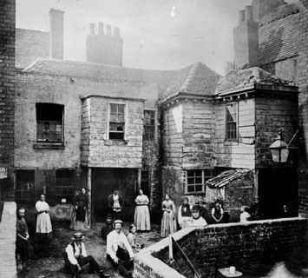
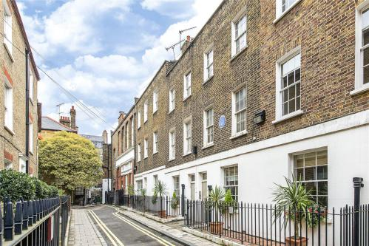
Changes in housing

Slide 6
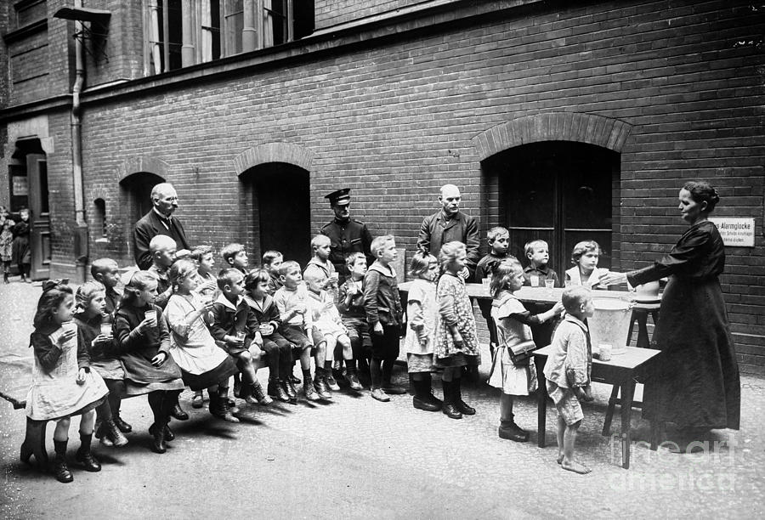

Salvation army
William Booth and Salvation Army (1865)
  refused to distinguish between deserving and undeserving poor; all worthy of help
“In the East End of London, revivalist preacher William Booth and his wife Catherine establish the Christian Mission, later known as the Salvation Army. Determined to wage war against the evils of poverty and religious indifference with military efficiency, Booth modeled his Methodist sect after the British army, labeling uniformed ministers as "officers" and new members as "recruits."
The Christian Mission, in which women were given ranks equal with men, launched "campaigns" into London's most forsaken neighborhoods. Soup kitchens were the first in a long line of various projects designed to provide physical and spiritual assistance to the destitute. In the early years, many in Britain were critical of the Christian Mission and its tactics, and the members were often subjected to fines and imprisonment as breakers of the peace.”
http://www.history.com/this-day-in-history/salvation-army-founded

Slide 7
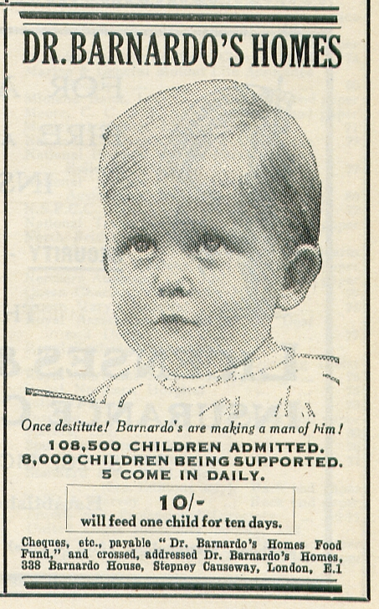
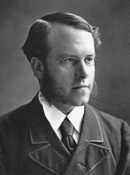
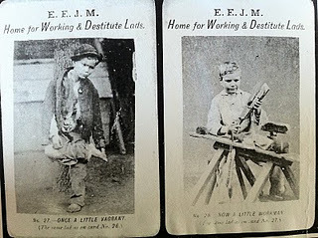
Thomas Barnardo and his homes
Thomas Barnardo
  Charity campaigner for destitute children
  Built children’s homes with the aim to feed, clothe and educate children
  Many of those rescued by him later migrated to the colonies > became successful
  100,000 children saved to this day
  Famous for the before/after photos

Slide 8
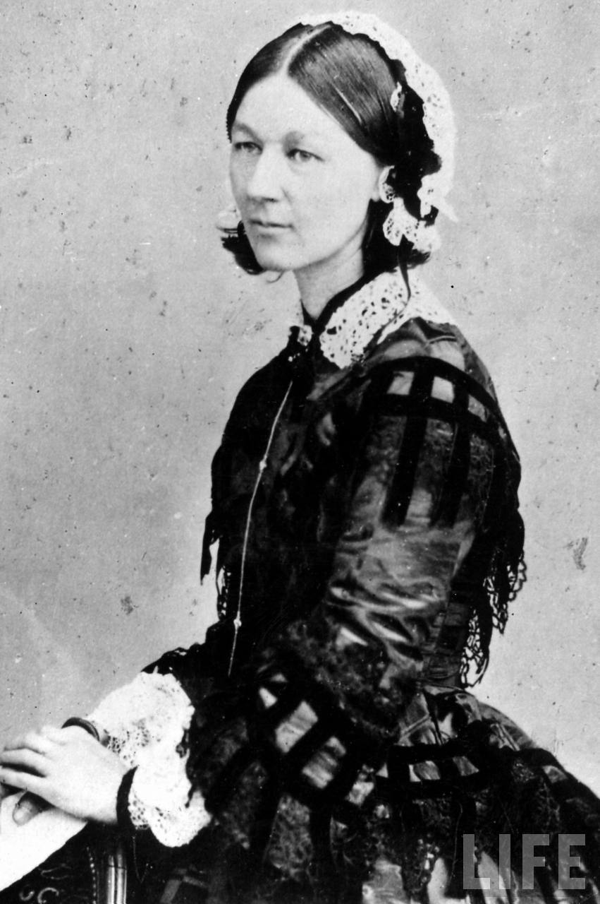
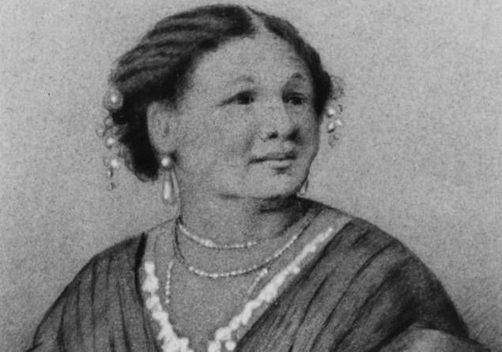
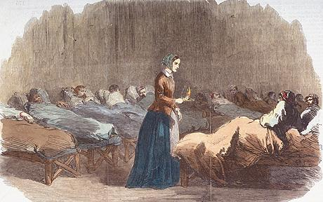
Pioneers of nursing: Florence nightingale and mary seacole

Slide 9
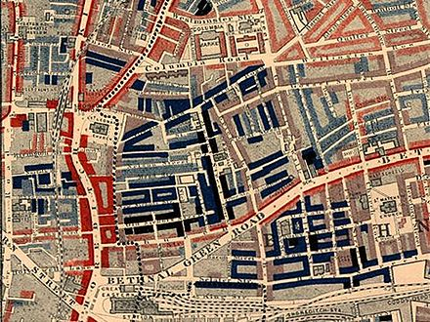
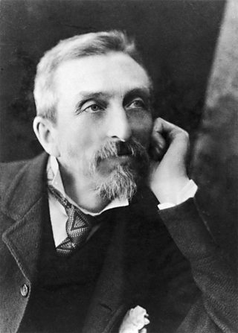
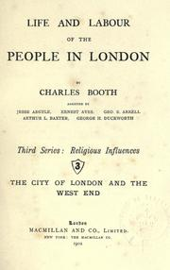
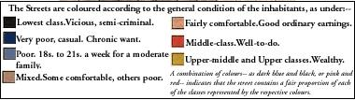
Charles Booth – origins of social research

Slide 10
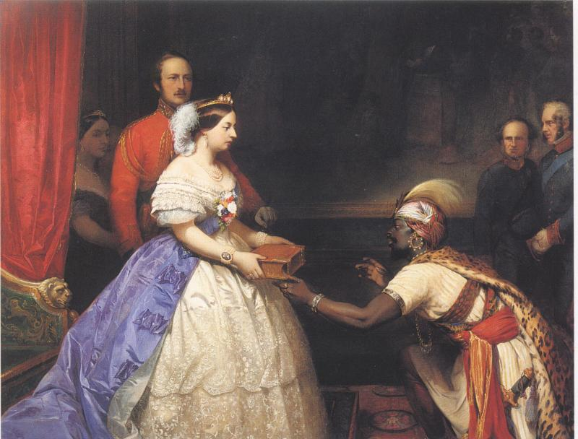
Images of Victorian Women

Slide 11
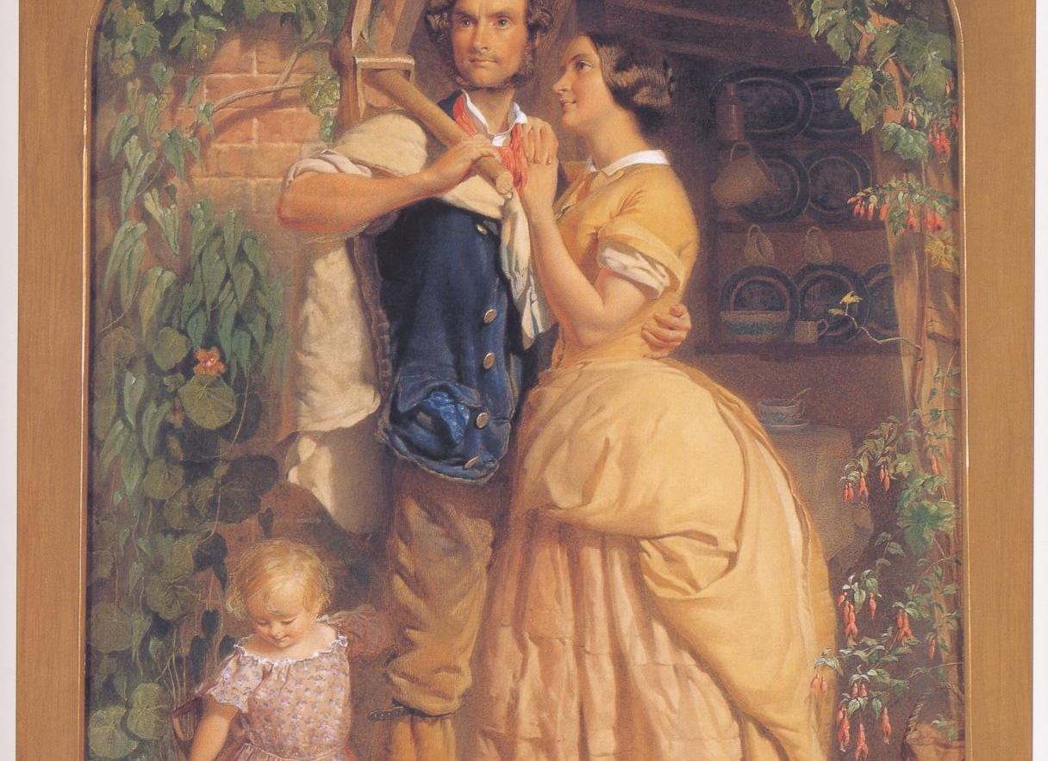
George Elgar Hicks,
The Sinews of Old England (1857)

Slide 12
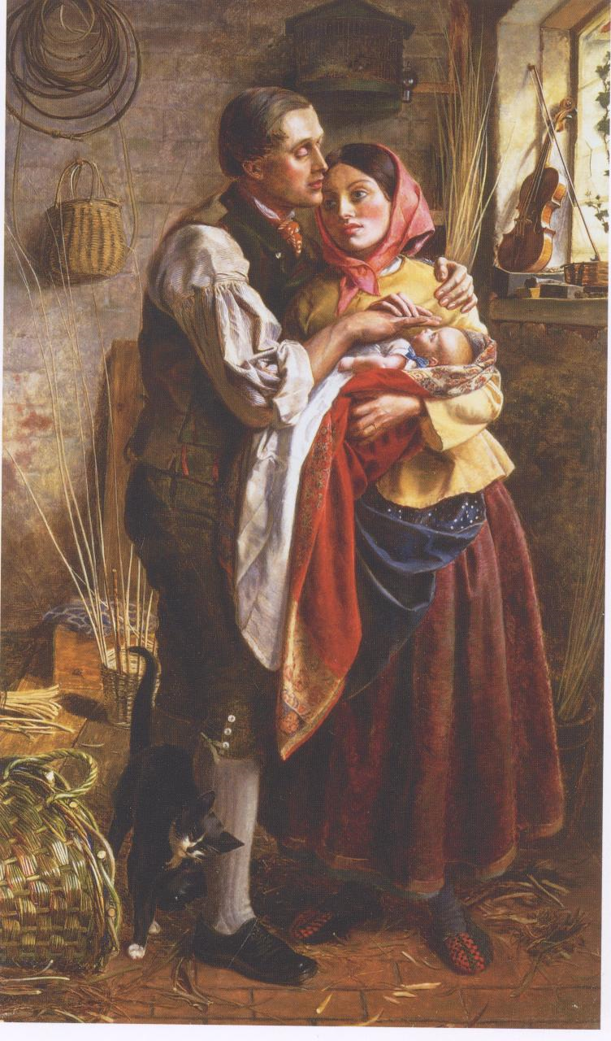
Michael Frederick Halliday,
The Blind Basket-maker with his First Child (1856)

Slide 13
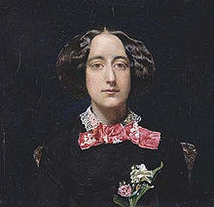
Angel in the house
At any time, she's still his wife,
Dearly devoted to his arms;
She loves with love that cannot tire;
And when, ah woe, she loves alone,
Through passionate duty love springs higher,
As grass grows taller round a stone.
Coventry Patmore (abridged)

Slide 14
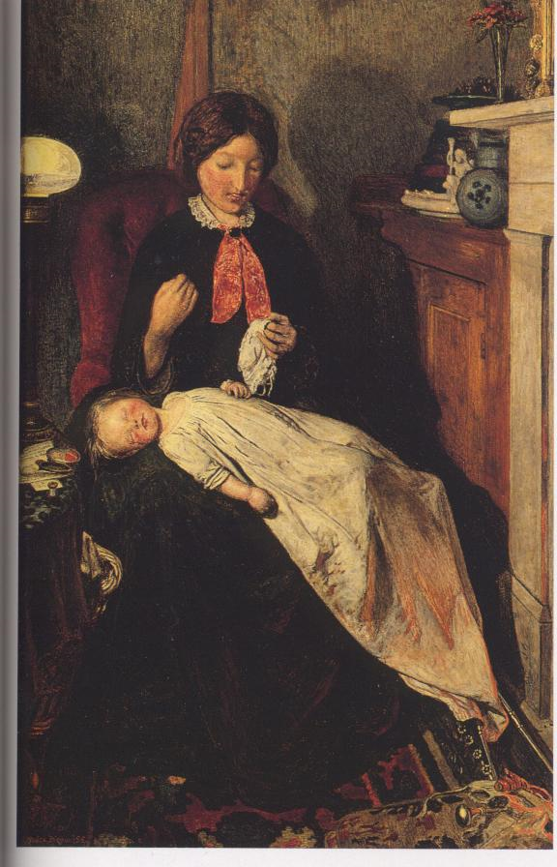
Ford Madox Brown,
Waiting: An English Fireside of
1854-5 (1855)

Slide 15
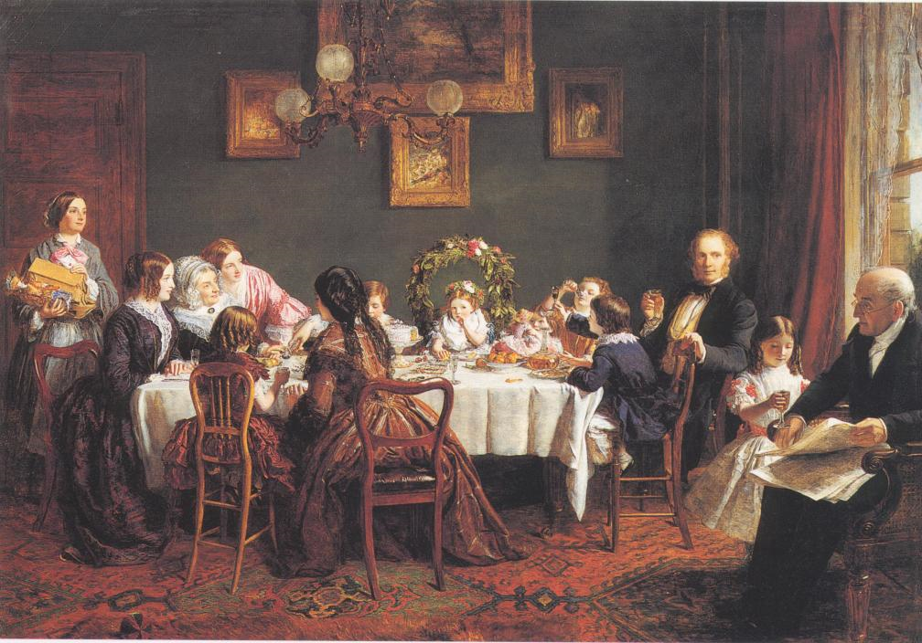
William Powell Frith, Many Happy Returns of the Day (1856)

Slide 16
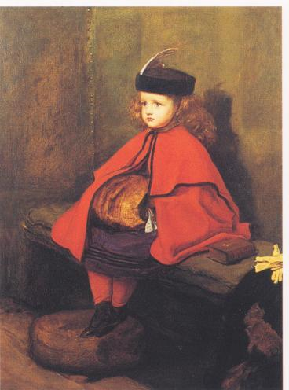
Sir John Everett Millais,
My First Sermon (1863)

Slide 17
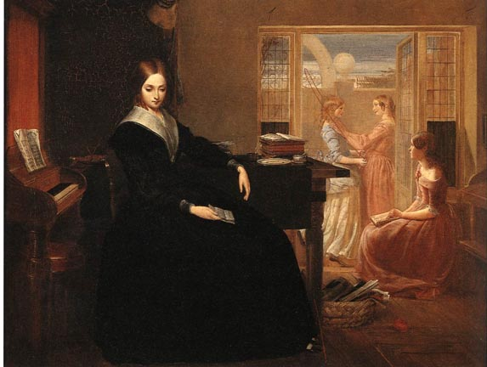
RichaRd Redgrave, The Poor Teacher (1844)

Slide 18
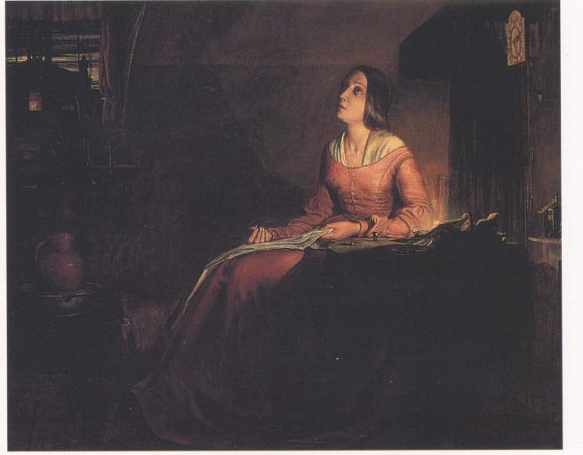
Richard Redgrave, The Sempstress (1846)

Slide 19
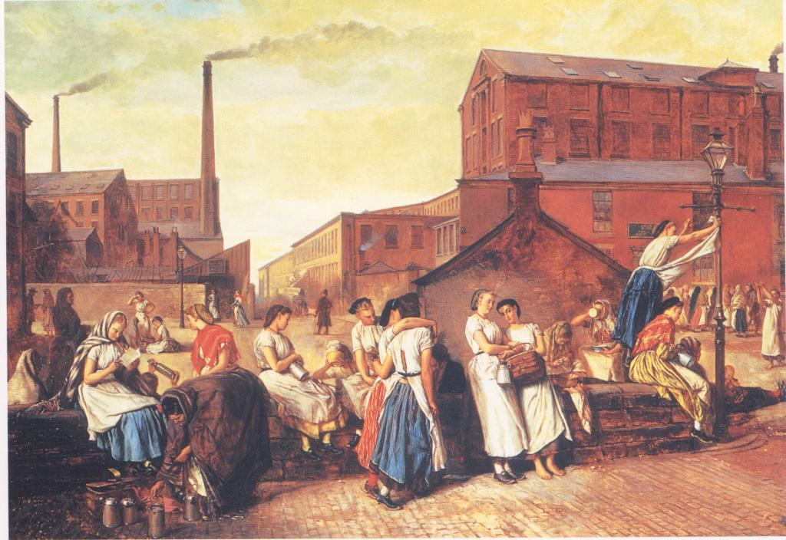
Eyre Crowe, The Dinner Hour at Wigan (1874)

Slide 20
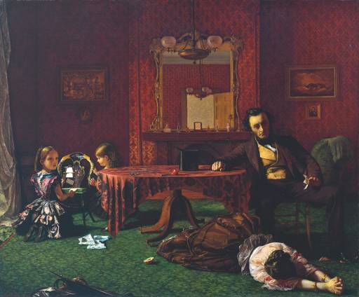
Augustus Leopold Egg, Past and Present(1) (1858)

Slide 21
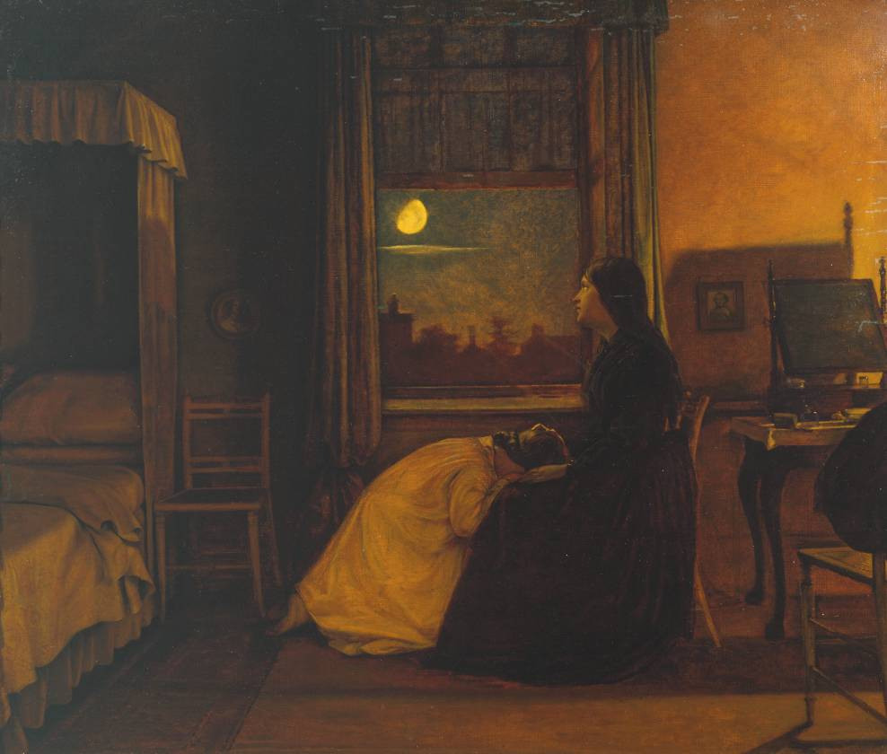
Augustus Leopold Egg, Past and Present(2) (1858)

Slide 22
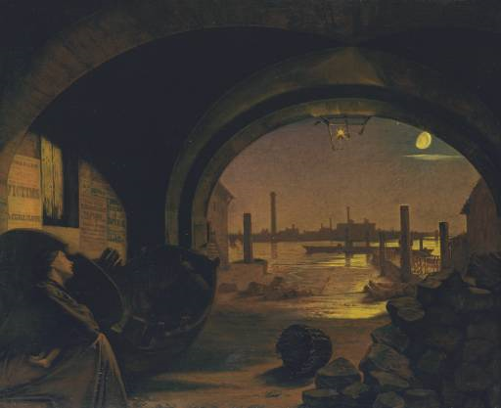
Augustus Leopold Egg, Past and Present(3) (1858)

Slide 23
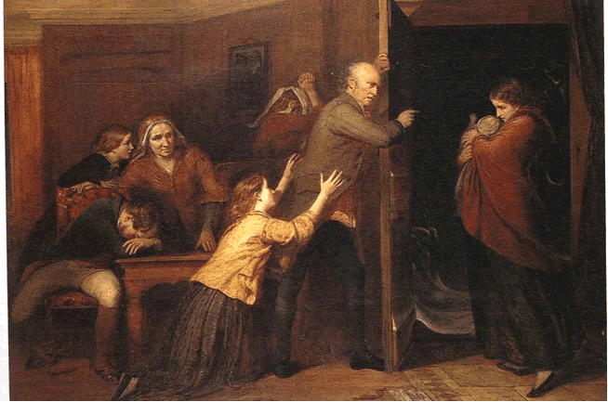
Richard Redgrave, The Outcast (1851)

Slide 24
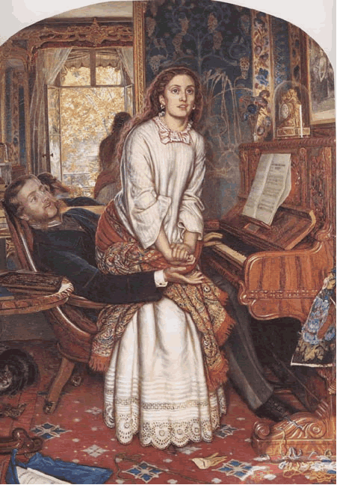
William Holman Hunt,
The Awakening Conscience (1853-54)

Slide 25
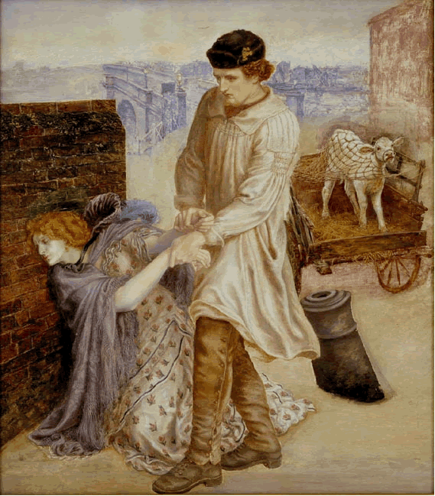
Dante Gabriel Rossetti,
Found (1853)

Slide 26
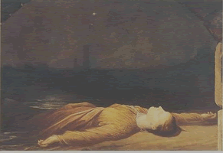
George Frederic Watts, Found Drowned (c. 1849-50)

Slide 27
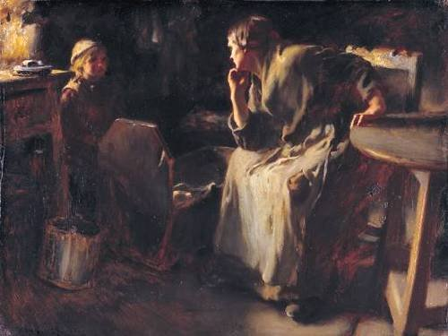
Frank Holl: Hush

Slide 28
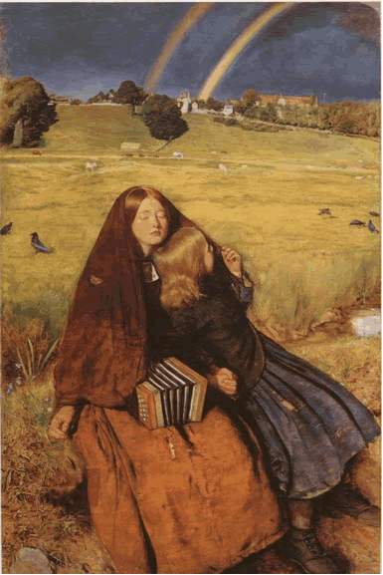
Sir John Everett Millais,
The Blind Girl (1854-56)

Slide 29
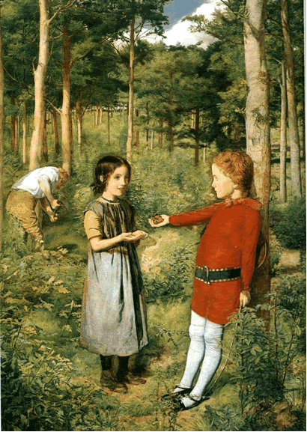
Sir John Everett Millais,
The Woodman's Daughter (1851)

Slide 30
The New Woman – two definitions
The new woman
By the 1890s, popular journals and magazines are publishing stories and articles about the 'new woman'. Often caricatured as a formidable virago, who wears her hair down, has a job, rides a bicycle, smokes and looks down on men, this image nevertheless reflects the changing role of women as more and more of them find new roles. The 'new woman' no longer needs a chaperone every time she goes out, and she can speak up for herself. Independent-minded, she is usually single and prefers a white-collar job to keeping house for a domineering male.
http://www.channel4.com/history/microsites/H/history/guide19/part10.html
The New Woman typically values self-fulfillment and independence rather than the stereotypically feminine ideal of self-sacrifice; believes in legal and sexual equality; often remains single because of the difficulty of combining such equality with marriage; is more open about her sexuality than the 'Old Woman'; is well-educated and reads a great deal; has a job; is athletic or otherwise physically vigorous and, accordingly, prefers comfortable clothes (sometimes male attire) to traditional female garb.
http://academic.brooklyn.cuny.edu/english/melani/cs6/newwoman.html

